Slide 1

MALLA REDDY COLLEGE OF ENGINEERING & TECHNOLOGY
Department of Aeronautical Engineering
MINI PROJECT
Design and Analysis of Propulsion System using AIML algorithms of a Gesture Control UAV with an integrated IOT Components
Under the Guidance of Presented by: Batch No: 12
Mr. M. Yugender SHAIK NAWAZ (20N31A2134)
Associate Professor TIRUMALA SAI NITHIN (20N31A2135)
V.HIMABINDU (20N31A2136)

Slide 2
ABSTRACT
This project focuses on the design and analysis of a propulsion system for a Gesture Control Unmanned Aerial Vehicle (UAV) using Artificial Intelligence and Machine Learning (AIML) algorithms, along with the integration of Internet of Things (IoT) components. The goal is to develop a UAV that can be controlled through hand gestures, providing an intuitive and user-friendly interface. The project encompasses the design of the propulsion system, implementation of AIML algorithms for gesture recognition, and integration of IoT components for real-time data transmission and remote control capabilities. The project outcomes showcase an innovative UAV system that combines AIML and IoT technologies, enabling enhanced user experience and expanding the potential applications of UAVs in various domains.

Slide 3
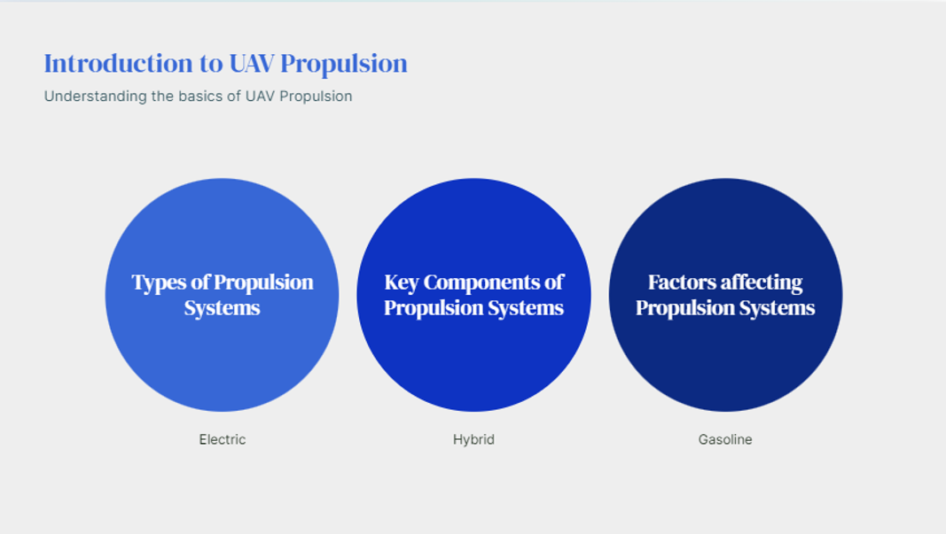

Slide 4
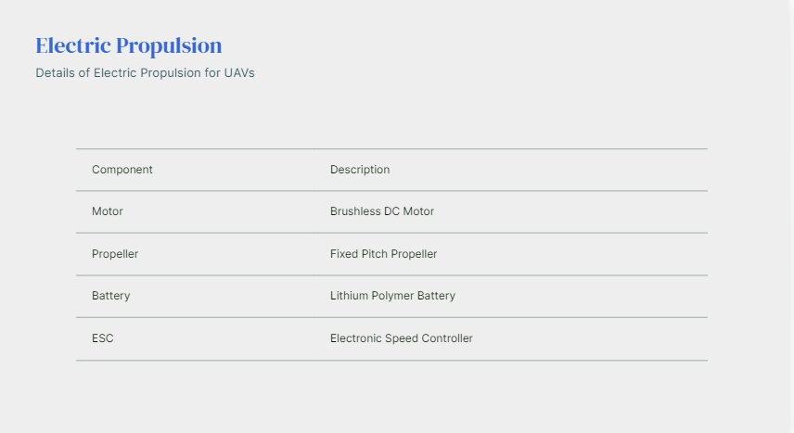

Slide 5
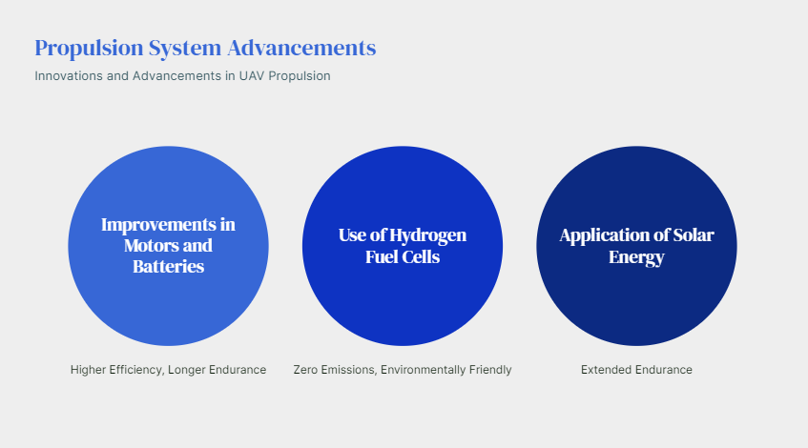

Slide 6
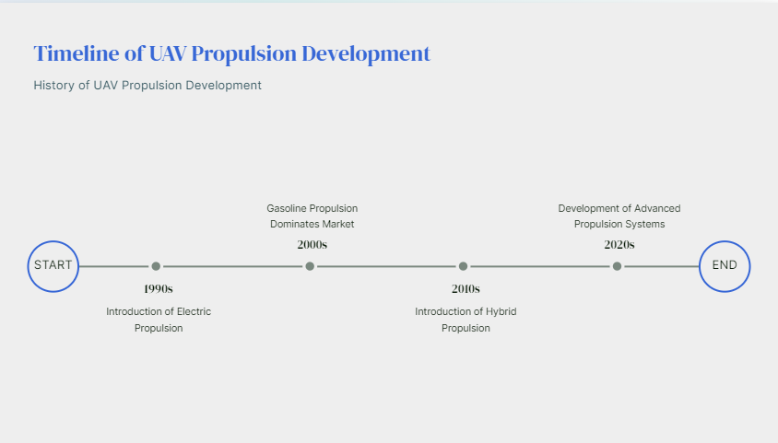

Slide 7
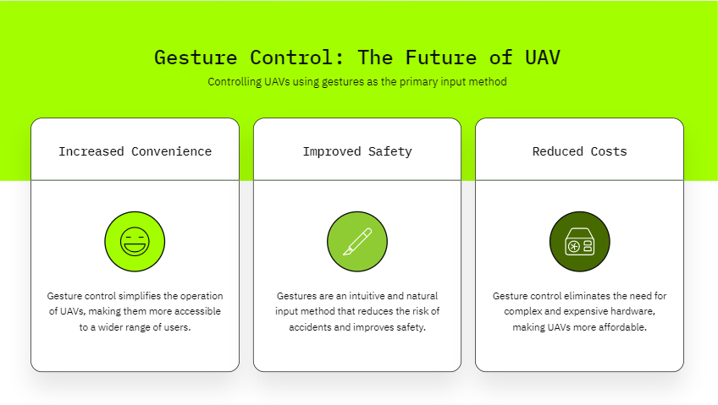

Slide 8
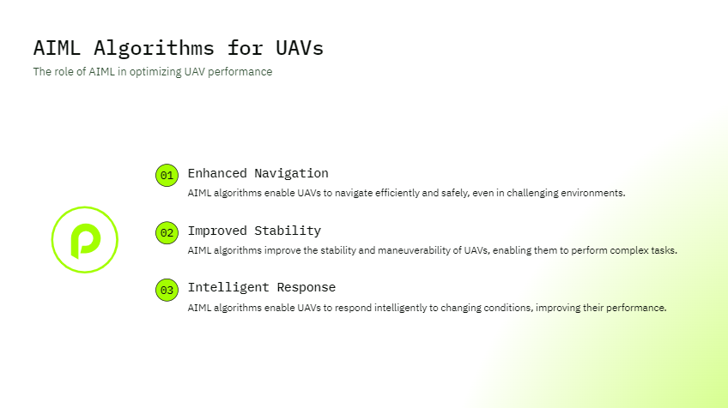

Slide 9
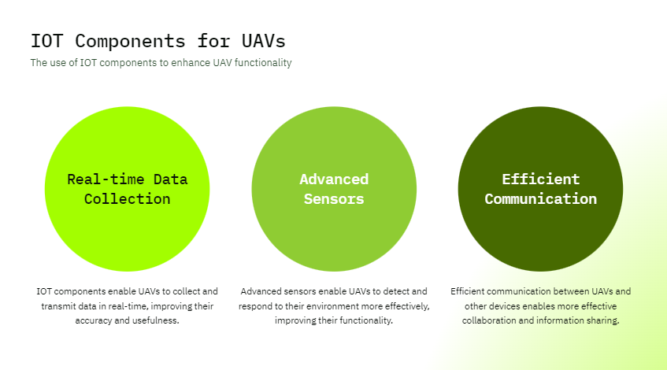

Slide 10
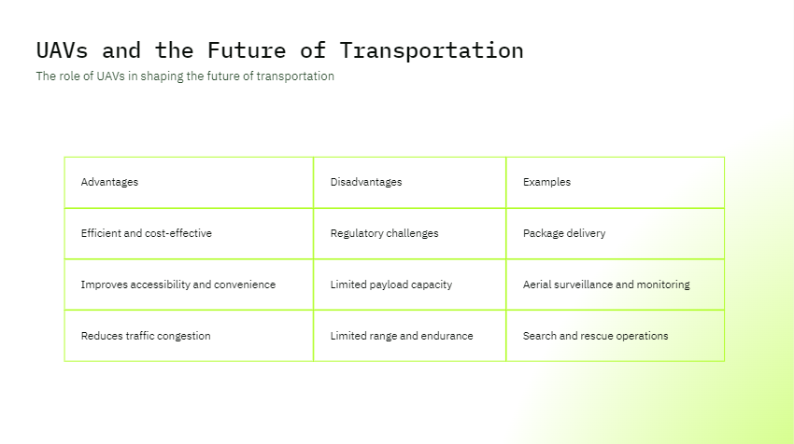

Slide 11
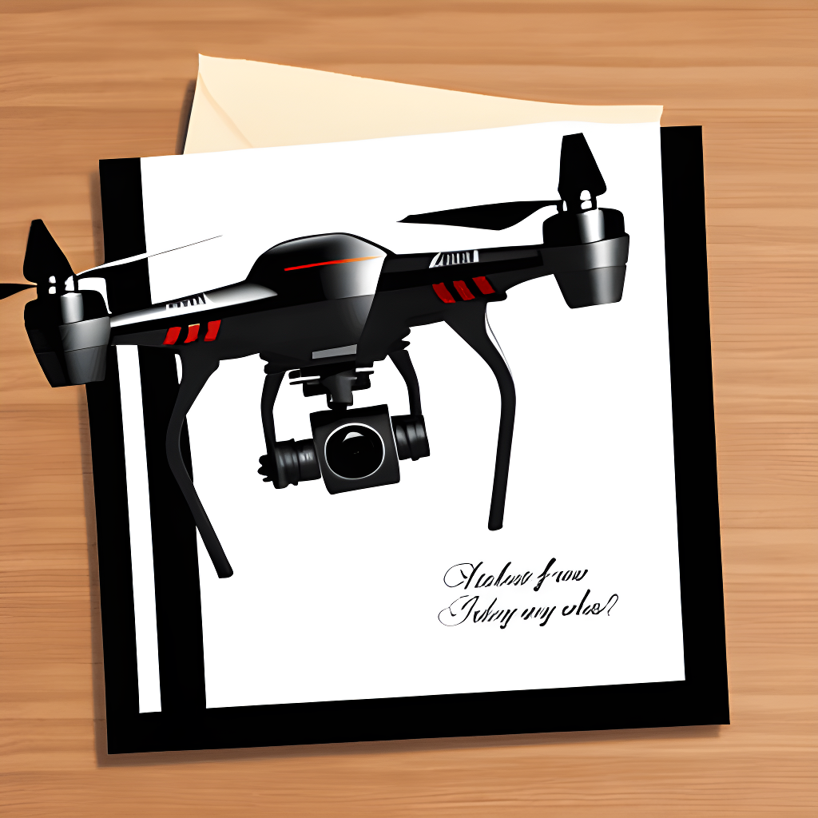
THANK YOU

